Slide 1

Of CORS It’s Exploitable!
Rebecca Deck
@ranger_cha
BE INFORMED. BE STRATEGIC. BE SECURE.

Slide 2
WHAT DO I DO?
Application security testing
Architecture / cloud configuration testing
Secure software development
Web apps, APIs, thick client apps, mobile, native apps
Slides and code at https://github.com/rangercha
Previously software dev, IR, forensics, sysadmin, & Army
Lots of certs, SANS master's program grad

Slide 3
OVERVIEW
REST & CORS Overview
CORS Bypasses
CORS & Scanners
Multi-step CORS Exploit
CORS Defenses

Slide 4
DON'T BE SCARED!!! (or bored☹)
If you know nothing about this topic…
Hopefully you understand 25%
If you know a little about the topic…
50-75%
If you are really solid in your knowledge of the topic…
Learn one or two new things

Slide 5

WHAT IS REST?
REpresentational State Transfer
Often uses extra HTTP methods
6 factors people don’t always use
Common API Type
Microservices
Model-View-Controller
Data can be in various formats
JSON, XML, YAML

Slide 6
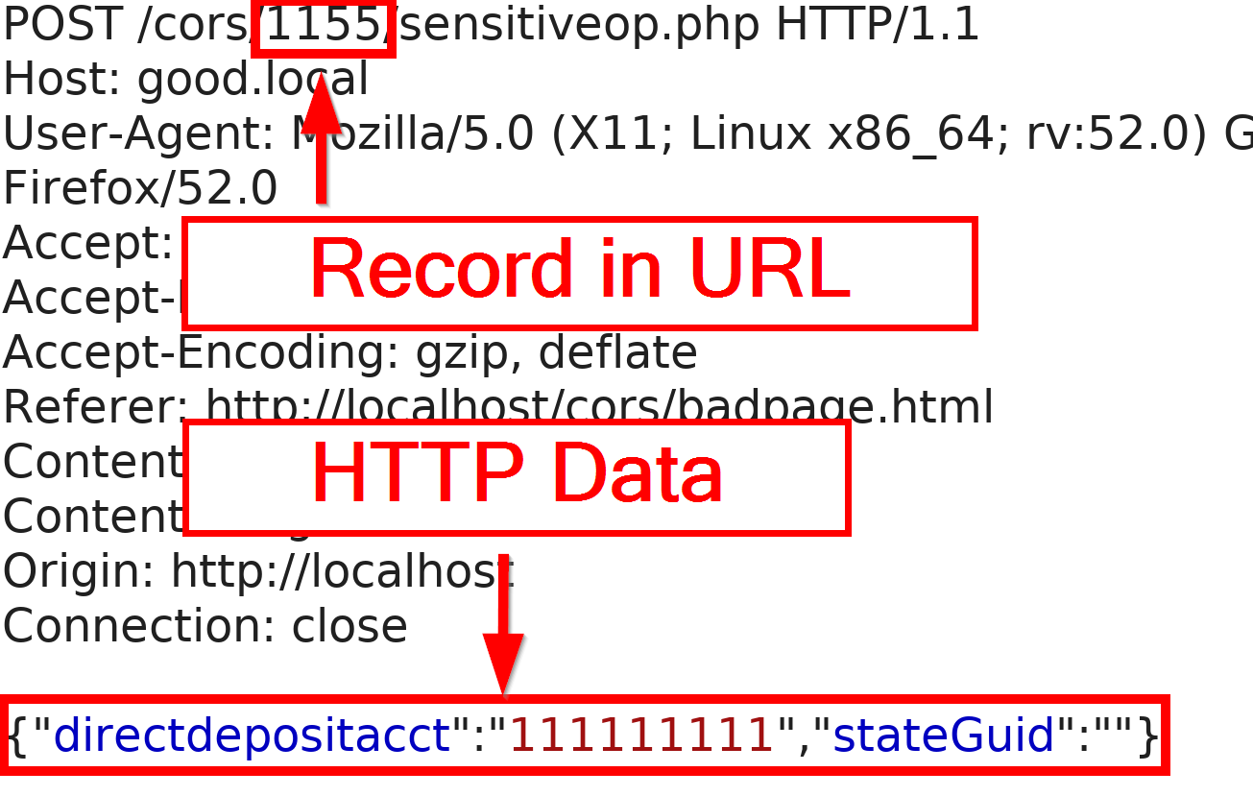
WHAT IS REST?

Slide 7

REST AUTHENTICATION
Not just cookies for session management
JWT or HMAC tokens
Multiple forms, sometimes used together
Cookies
Bearer Header
Custom Headers

Slide 8
WHAT IS A CROSS-ORIGIN REQUEST?
Sometimes web content and APIs are on different servers
XHR (XML HTTP Request) between origins (that gets sticky)
Content on site A makes users send requests to site B
Malicious sites might…
Force a user to change their email address
Send request to internal server
Sounds an awful lot like cross-site request forgery (CSRF)

Slide 9
WHAT IS CORS?
Browser protection
Defined in Fetch spec
Very granular
Generally more complex than tokens
Easy to misconfigure

Slide 10
CORS DETAILS
Browser sends pre-flight request (OPTIONS)
Server sends response
Client decides if the full request is permitted
Client sends full request if permitted

Slide 11


CORS DETAILS
Client
Pre-flight OPTIONS
Server
Pre-flight Response
Actual Request
Actual Response
https://www.shutterstock.com/image-vector/cartoon-illustration-happy-daisy-love-528516562 https://tattly.com/products/rainbow

Slide 12
CORS REQUEST HEADERS FOR PRE-FLIGHT
Origin
Access-Control-Request-
Method
Headers

Slide 13
CORS PRE-FLIGHT RESPONSE HEADERS
Access-Control-Allow
Origin (ACAO)
Credentials
Methods
Headers
Access-Control-Expose-Headers
Access-Control-Max-Age
Notes:
What do devs do when their software doesn't work?

Slide 14
CORS DEV LIFE
Writing some code to test your API
API is on a different port than the test app
Keep getting weird CORS errors in JavaScript debug…
What do you do?
Notes:
What do devs do when their software doesn't work?

Slide 15
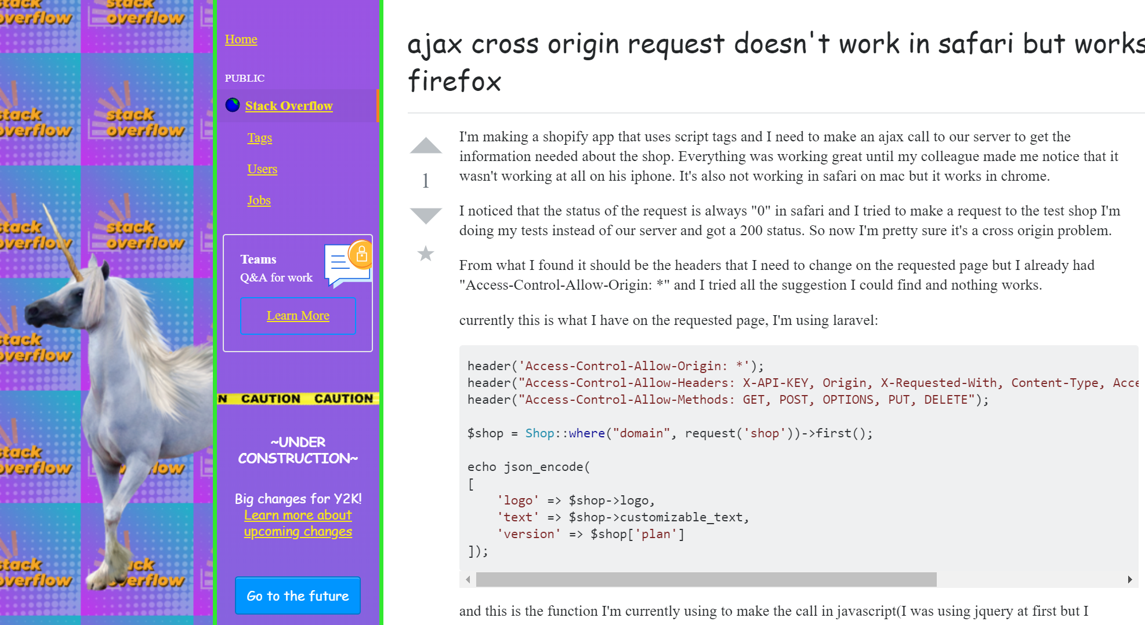

Slide 16
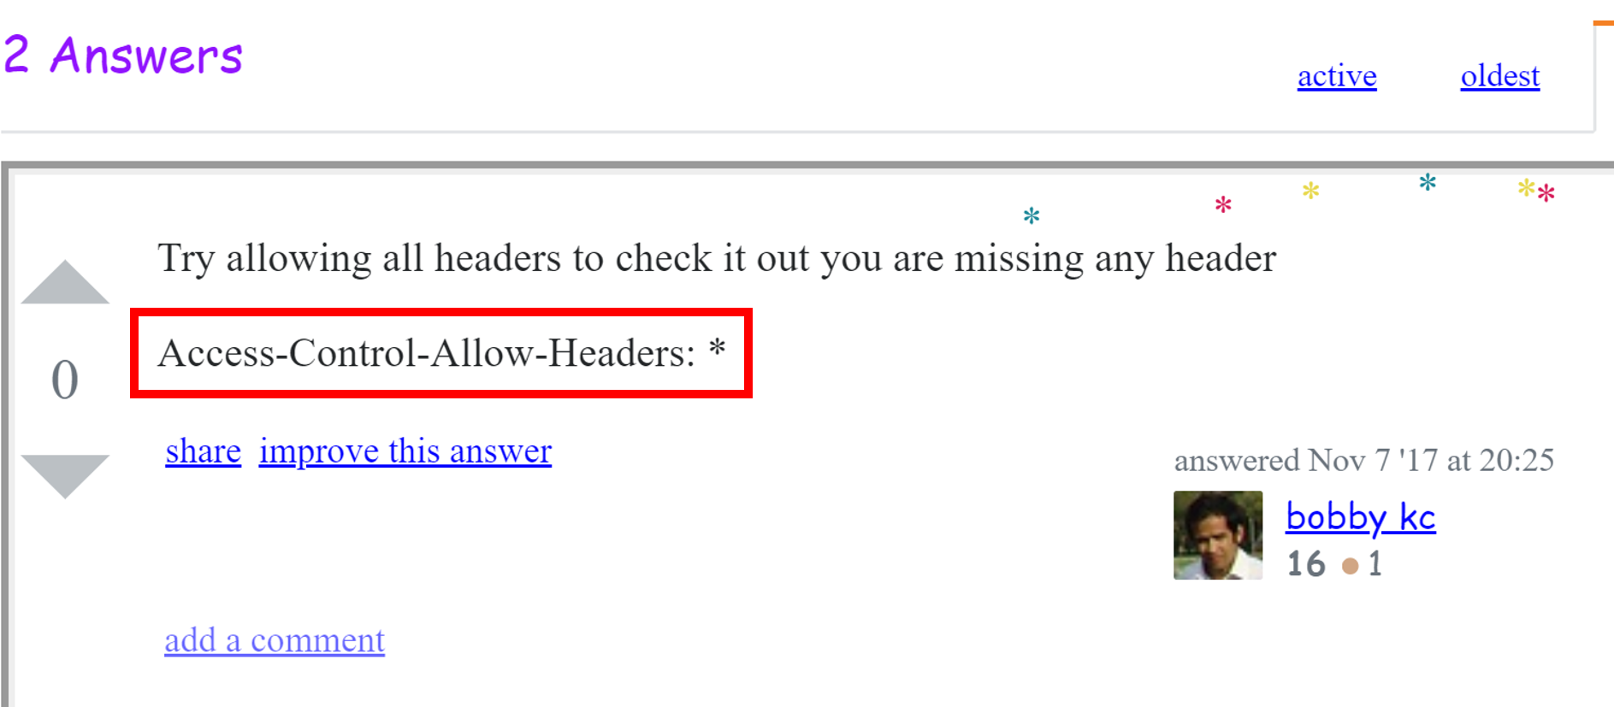

Slide 17
BYPASSING CORS Origin
Origin controls where requests come from
Fundamental to CORS security
ACAO supports wildcards & exact matches
*
Only for open APIs
https://www.good.local

Slide 18
BYPASSING CORS Access-Control-Allow-Credentials
Causes browser to
Send cookies
Send Authorization (basic & NTLM)
Does not support wildcards in ACAO
Often parrots origin header
Hard to do check origin for on-prem apps
Otherwise, uses regex
May be wrong

Slide 19
BYPASSING CORS Origin Examples
Regex | Bypass with
.* | Literally anything
good.local | goodalocal.evil.local
^.*good\.local | good.local.evil.local

Slide 20
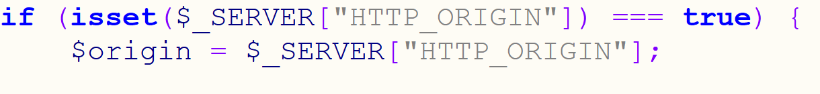
BYPASSING CORS Bad Origin Example Code

Slide 21
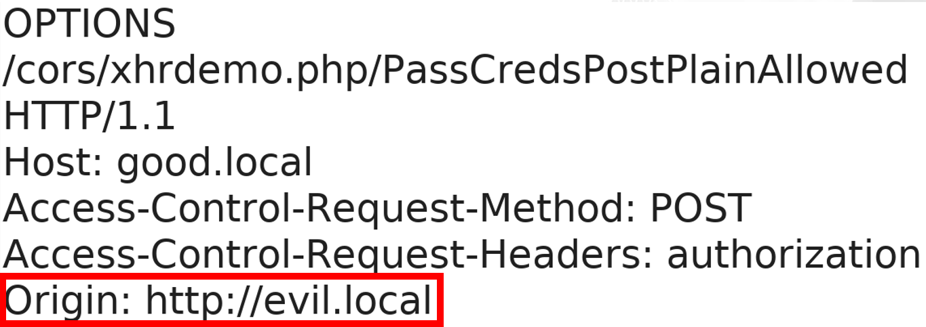
BYPASSING CORS
Client
Pre-flight
Server

Slide 22
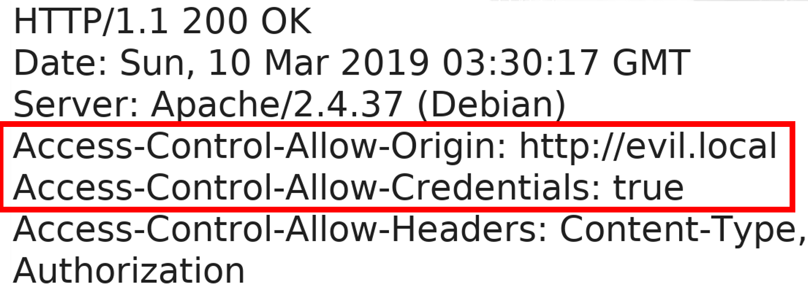
BYPASSING CORS
Client
Pre-flight Response
Server

Slide 23
BYPASSING CORS Avoiding Pre-flight Requests
Simple requests
GET, HEAD, or POST
A few headers
Content-Type
application/x-www-form-urlencoded
multipart/form-data
text/plain

Slide 24
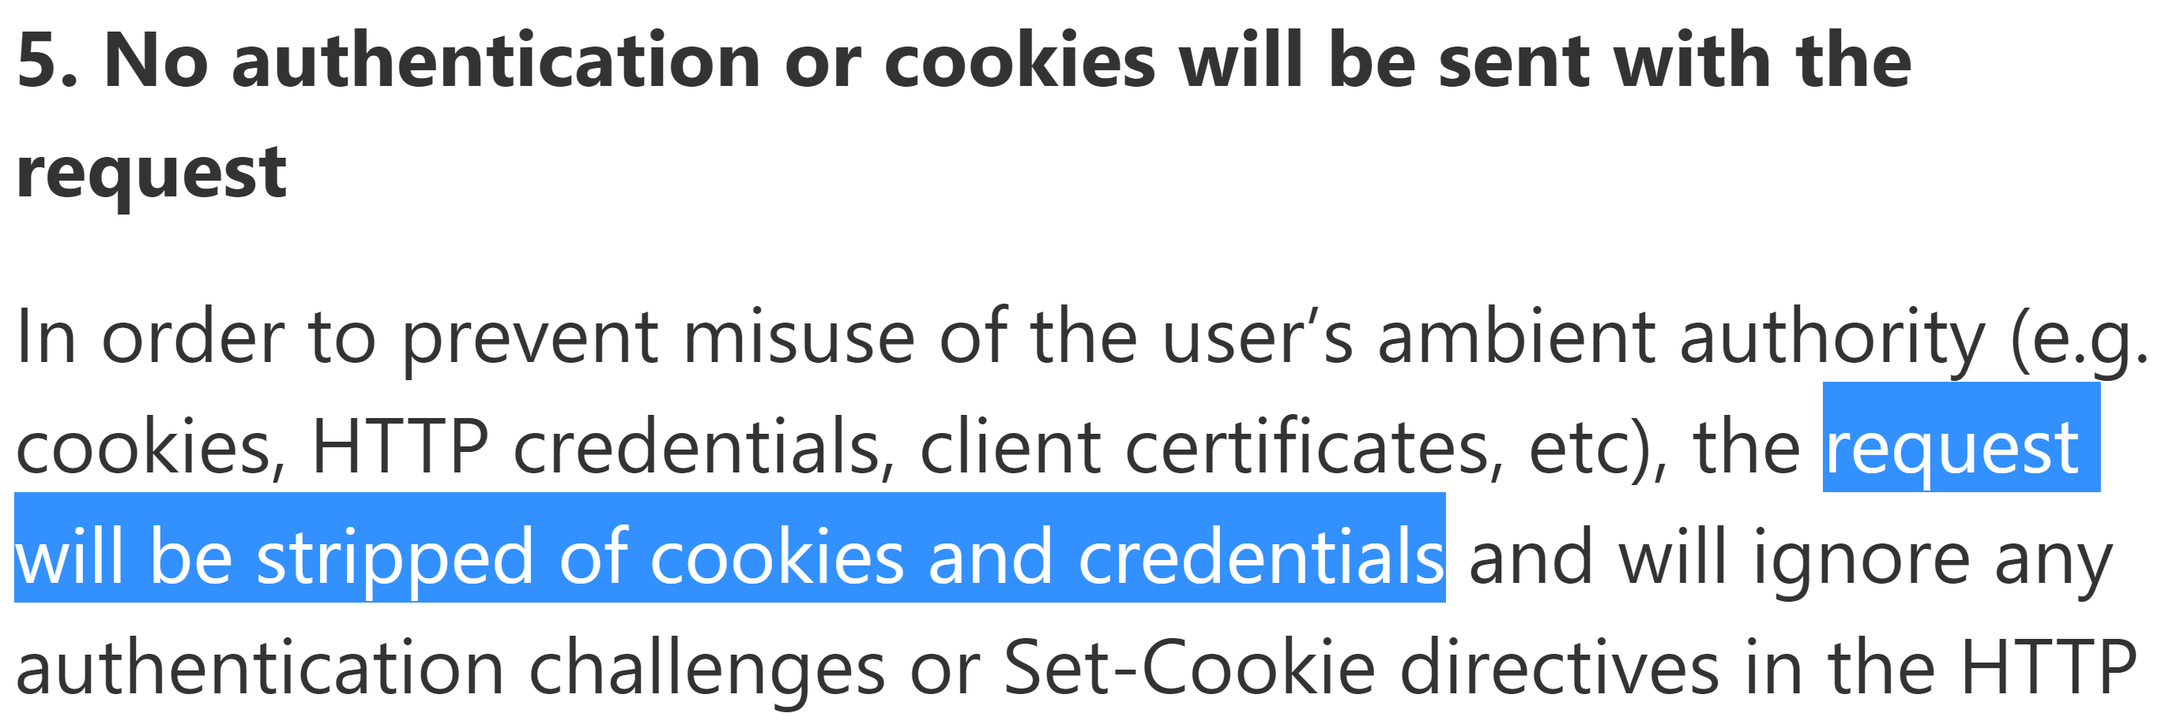
BYPASSING CORS Avoiding Pre-flight Requests
https://blogs.msdn.microsoft.com/ieinternals/2010/05/13/xdomainrequest-restrictions-limitations-and-workarounds/

Slide 25
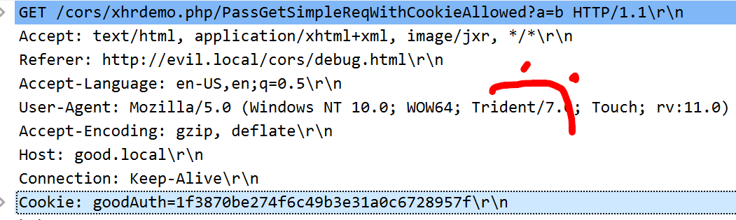
BYPASSING CORS Avoiding Pre-flight Requests
(╯°□°）╯︵ ┻━┻

Slide 26
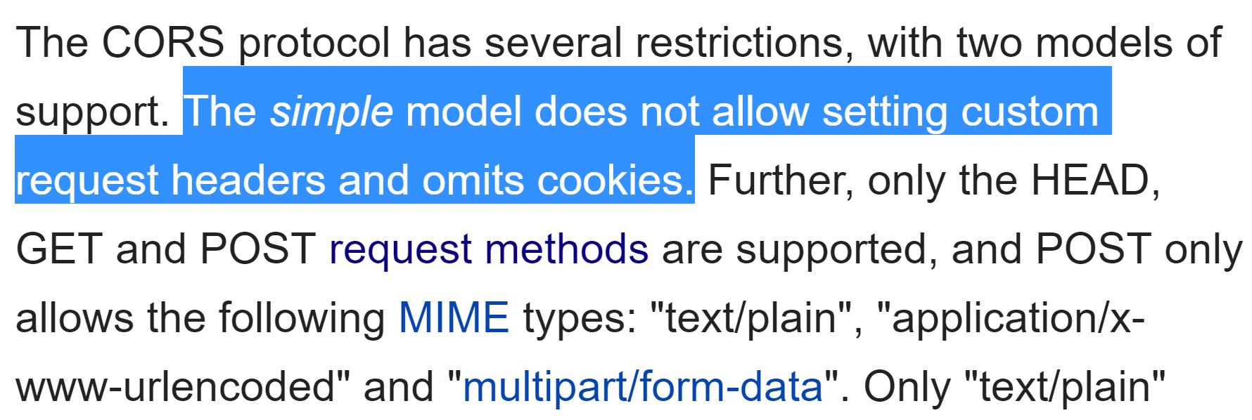
BYPASSING CORS Avoiding Pre-flight Requests
https://en.wikipedia.org/wiki/XMLHttpRequest

Slide 27
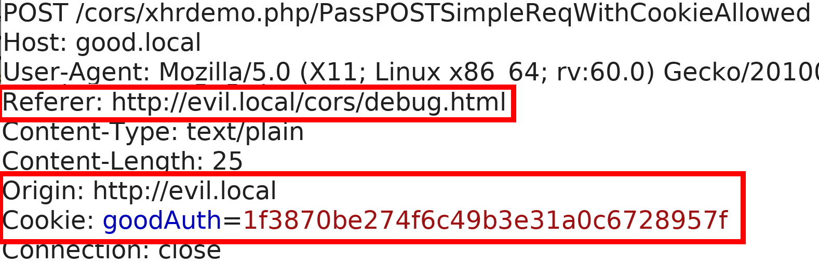
BYPASSING CORS Avoiding Pre-flight Requests Examples
Client
POST
Server

Slide 28
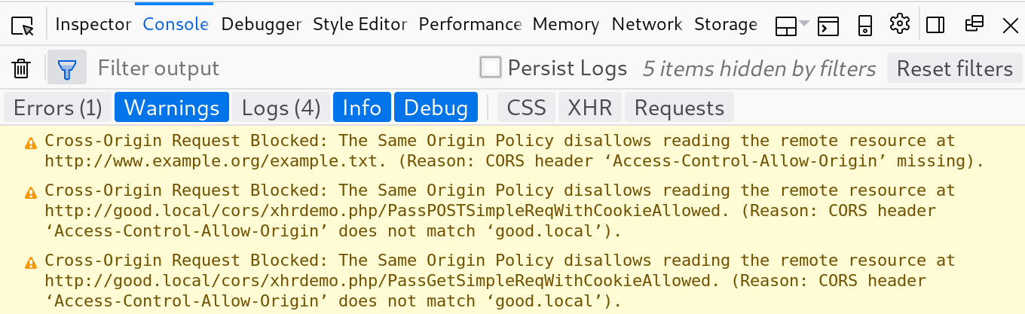
BYPASSING CORS Avoiding Pre-flight Requests Examples

Slide 29
COMMON CORS PITFALLS BY TESTERS
Scanners are pretty sad
Over-reliance on Origin
Ignoring custom headers
Forget the pre-flight
Don’t modify multiple parts of the request
Customers think we are wrong
They have been hurt before!
Thinking we’re limited to one request
Think GUIDs protect them

Slide 30

https://memegenerator.net/instance/65011824/sean-connery-celebrity-jeopardy-snl-ill-play-your-game-you-rogue

Slide 31
MULTI-STEP CORS EXPLOIT EXAMPLE
Software handling financial payments
GET to REST API to list all accounts
POST to REST weird "prepare to update" step with GUID
POST to REST API to update direct deposit
Reflected Origin header
Session cookie to handle authentication
Used WithCredentials on XHR

Slide 32
MULTI-STEP CORS EXPLOIT EXAMPLE
Five-step exploit
Request list of accounts
Parse JSON to retrieve account info
“Prepare to edit” Request
Get GUID
POST to update direct deposit
Scanner finding (from Burp)
CORS Arbitrary Origin Trusted

Slide 33
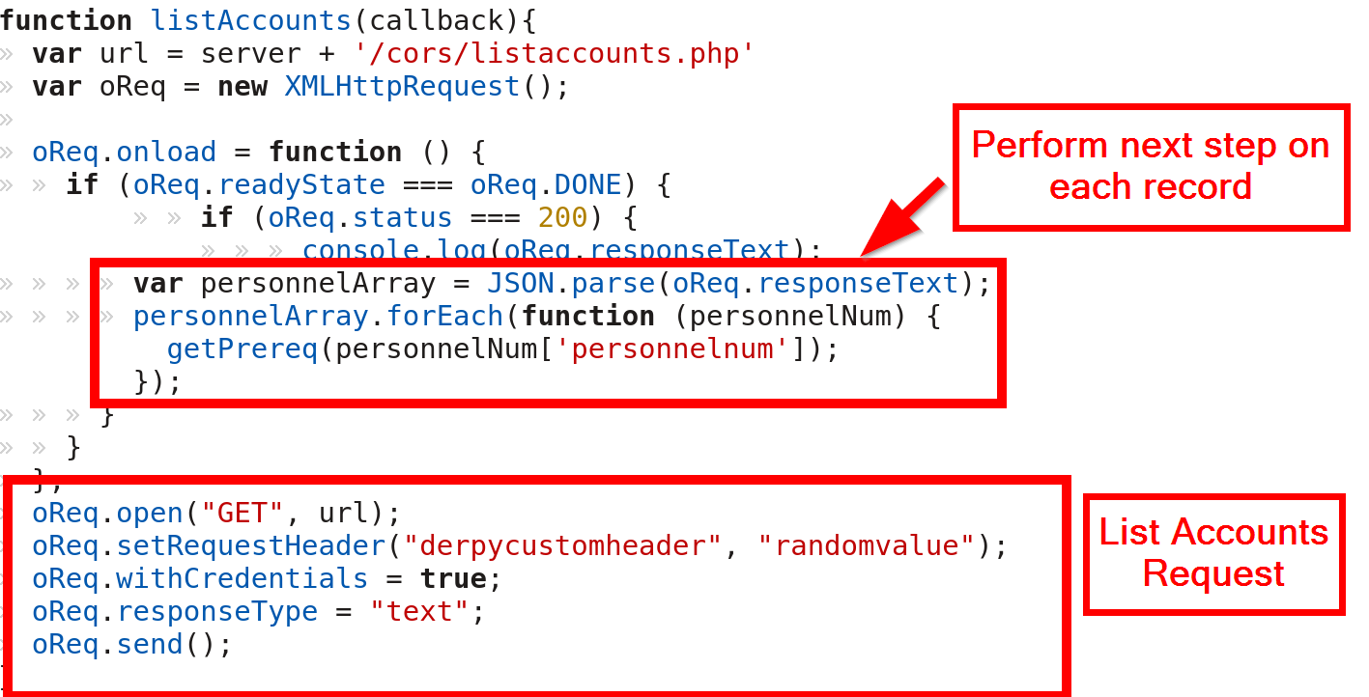
MULTI-STEP CORS EXPLOIT EXAMPLE

Slide 34
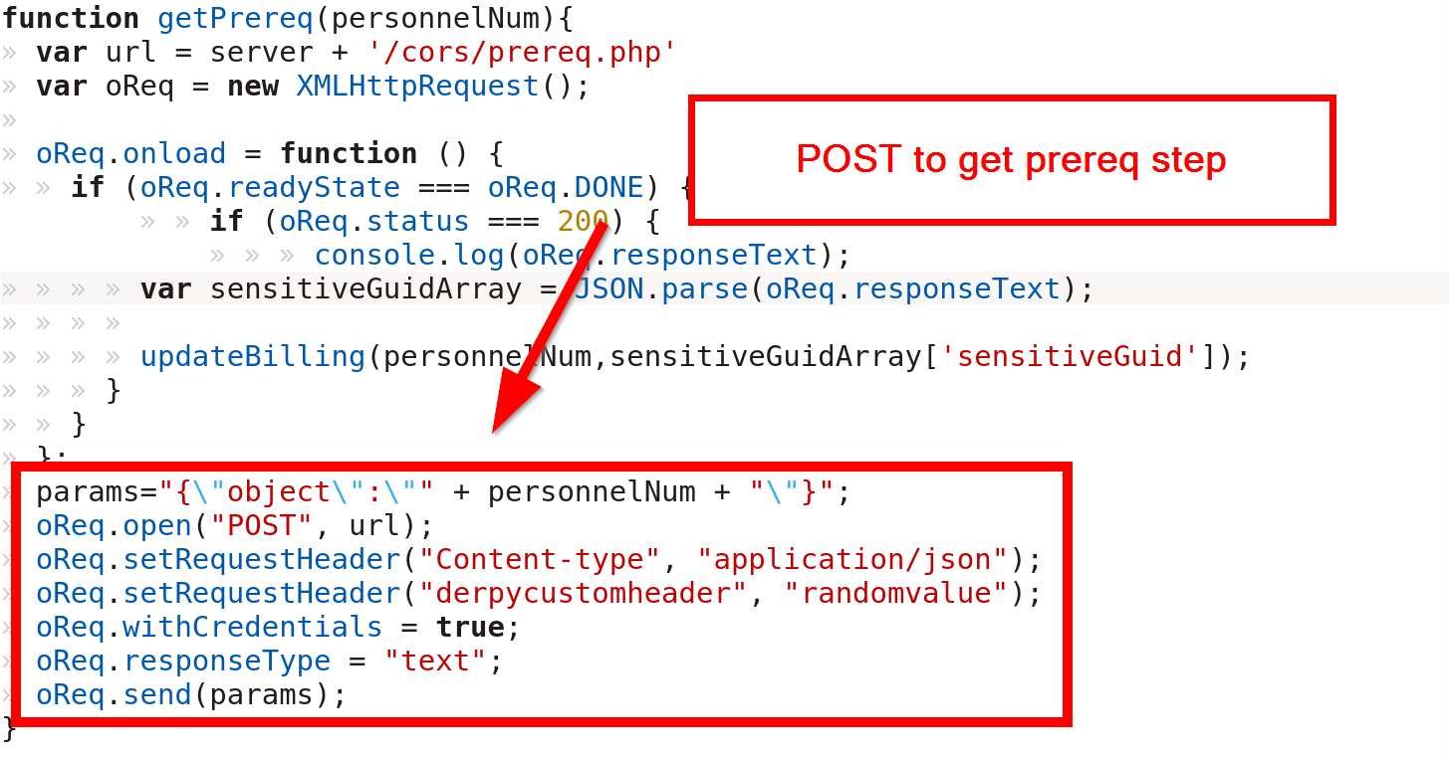
MULTI-STEP CORS EXPLOIT EXAMPLE

Slide 35
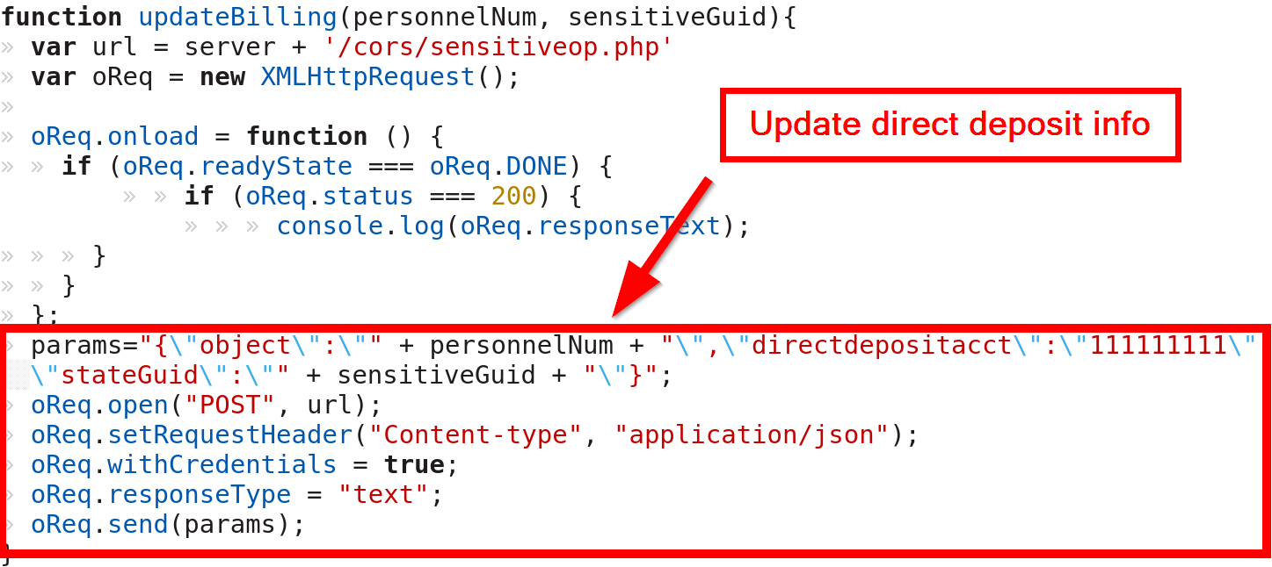
MULTI-STEP CORS EXPLOIT EXAMPLE

Slide 36
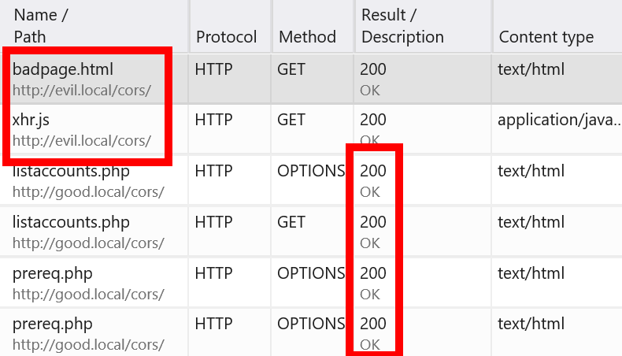
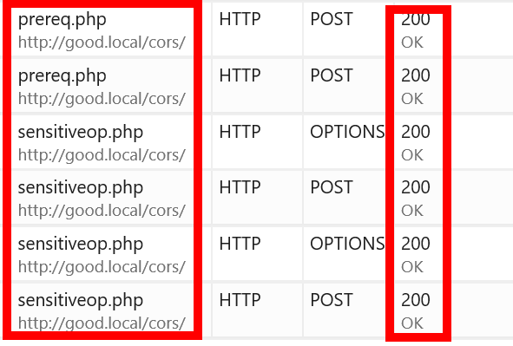
MULTI-STEP CORS EXPLOIT EXAMPLE

Slide 37
CORS DEFENSES
Load balancers are a great place to fix this
Intentional Defenses
Origin Header
Limit as much as possible
Use regex and whitelists
Nonce Tokens
Double submit cookies
Referer Headers
Accidental Defenses
Custom Headers

Slide 38
DO AUTHORIZATION HEADERS HELP?
Sites with access to token must have no XSS
Token must be unpredictable
Token must be unique per user
Receiving system must validate token
Attacker must not be able to generate tokens for another user
Apps must never put the token in an insecure place (URL)

Slide 39
SUMMARY
CORS secures XHR requests
Origin is important!
Attack with “simple” requests
Multi-step attacks are possible!

Slide 40
RESOURCES
Portswigger CORS
https://portswigger.net/blog/exploiting-cors-misconfigurations-for-bitcoins-and-bounties
Mozilla CORS Info
https://developer.mozilla.org/en-US/docs/Web/HTTP/CORS
W3C CORS
https://www.w3.org/TR/cors/
OWASP CSRF
https://github.com/OWASP/CheatSheetSeries/blob/master/cheatsheets/Cross-Site_Request_Forgery_Prevention_Cheat_Sheet.md

Slide 41
RESOURCES
Fetch Spec
https://fetch.spec.whatwg.org/
Example XHR Code
https://github.com/rangercha/CORSRequestPOC
CORS Exploitation Framework (not out)
Detailed CORS Simple Requests Research
https://research.aurainfosec.io/same-origin-policy/

Slide 42
www.directdefense.com

